Slide 1
Abnormality Detection in Musculoskeletal Radiographs
Team 12
DS 5220
Sayan Biswas
Sneha Agarwal
DS 5220 Project Presentation

Slide 2
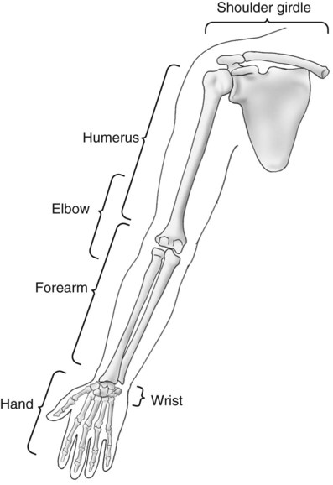
MURA Dataset
MURA (musculoskeletal radiographs) is a large dataset of bone X-rays.
Each study contains one or more images and is manually
labelled by radiologists as ‘Normal’ or ‘Abnormal’.
The images are X-rays of different body parts-wrist,
shoulder, elbow, hand, finger, forearm and humerus.
MURA dataset comes with train and valid folders
containing corresponding datasets.
Aims to lead to a significant advancement in medical
imaging technologies which can diagnose at the level of
experts.

Slide 3
The Goal
Can we classify radiographic images to their respective study type?
Can we classify radiographic images belonging to their respective study type as Normal or Abnormal?

Slide 4
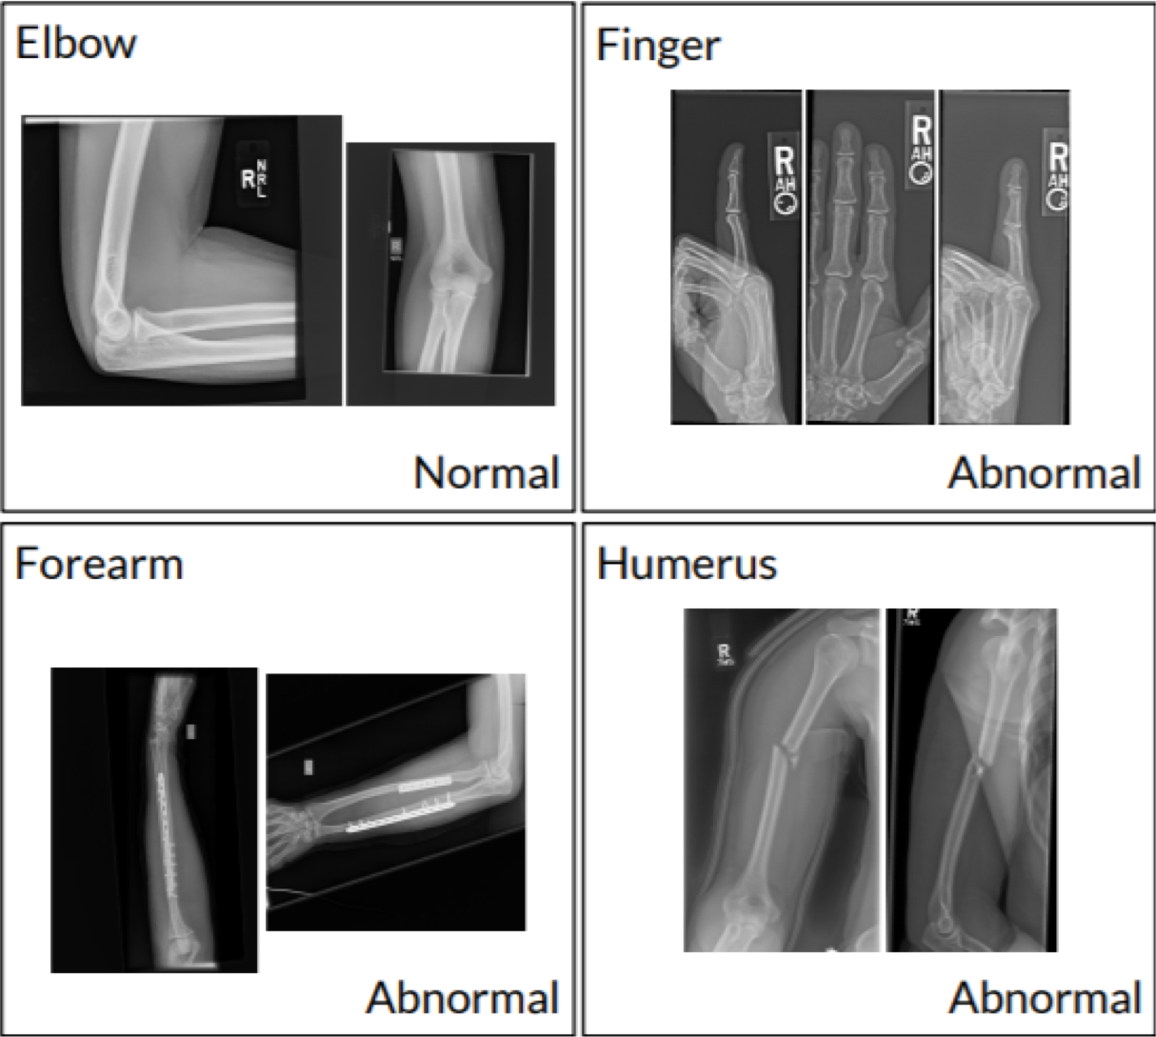
Summary of Data
~41,000 images from ~15,000 studies (patients) including train and validation sets
9,000 studies of normal (negative condition) and 6,000 of abnormal studies (positive condition)
Typical image res: 500 x 500 pixels

Slide 5
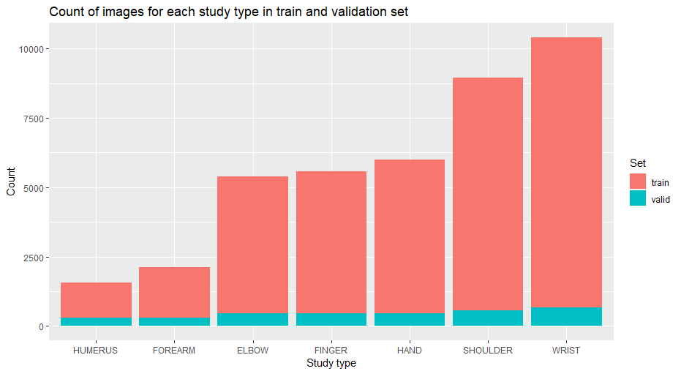
Size of Dataset

Slide 6
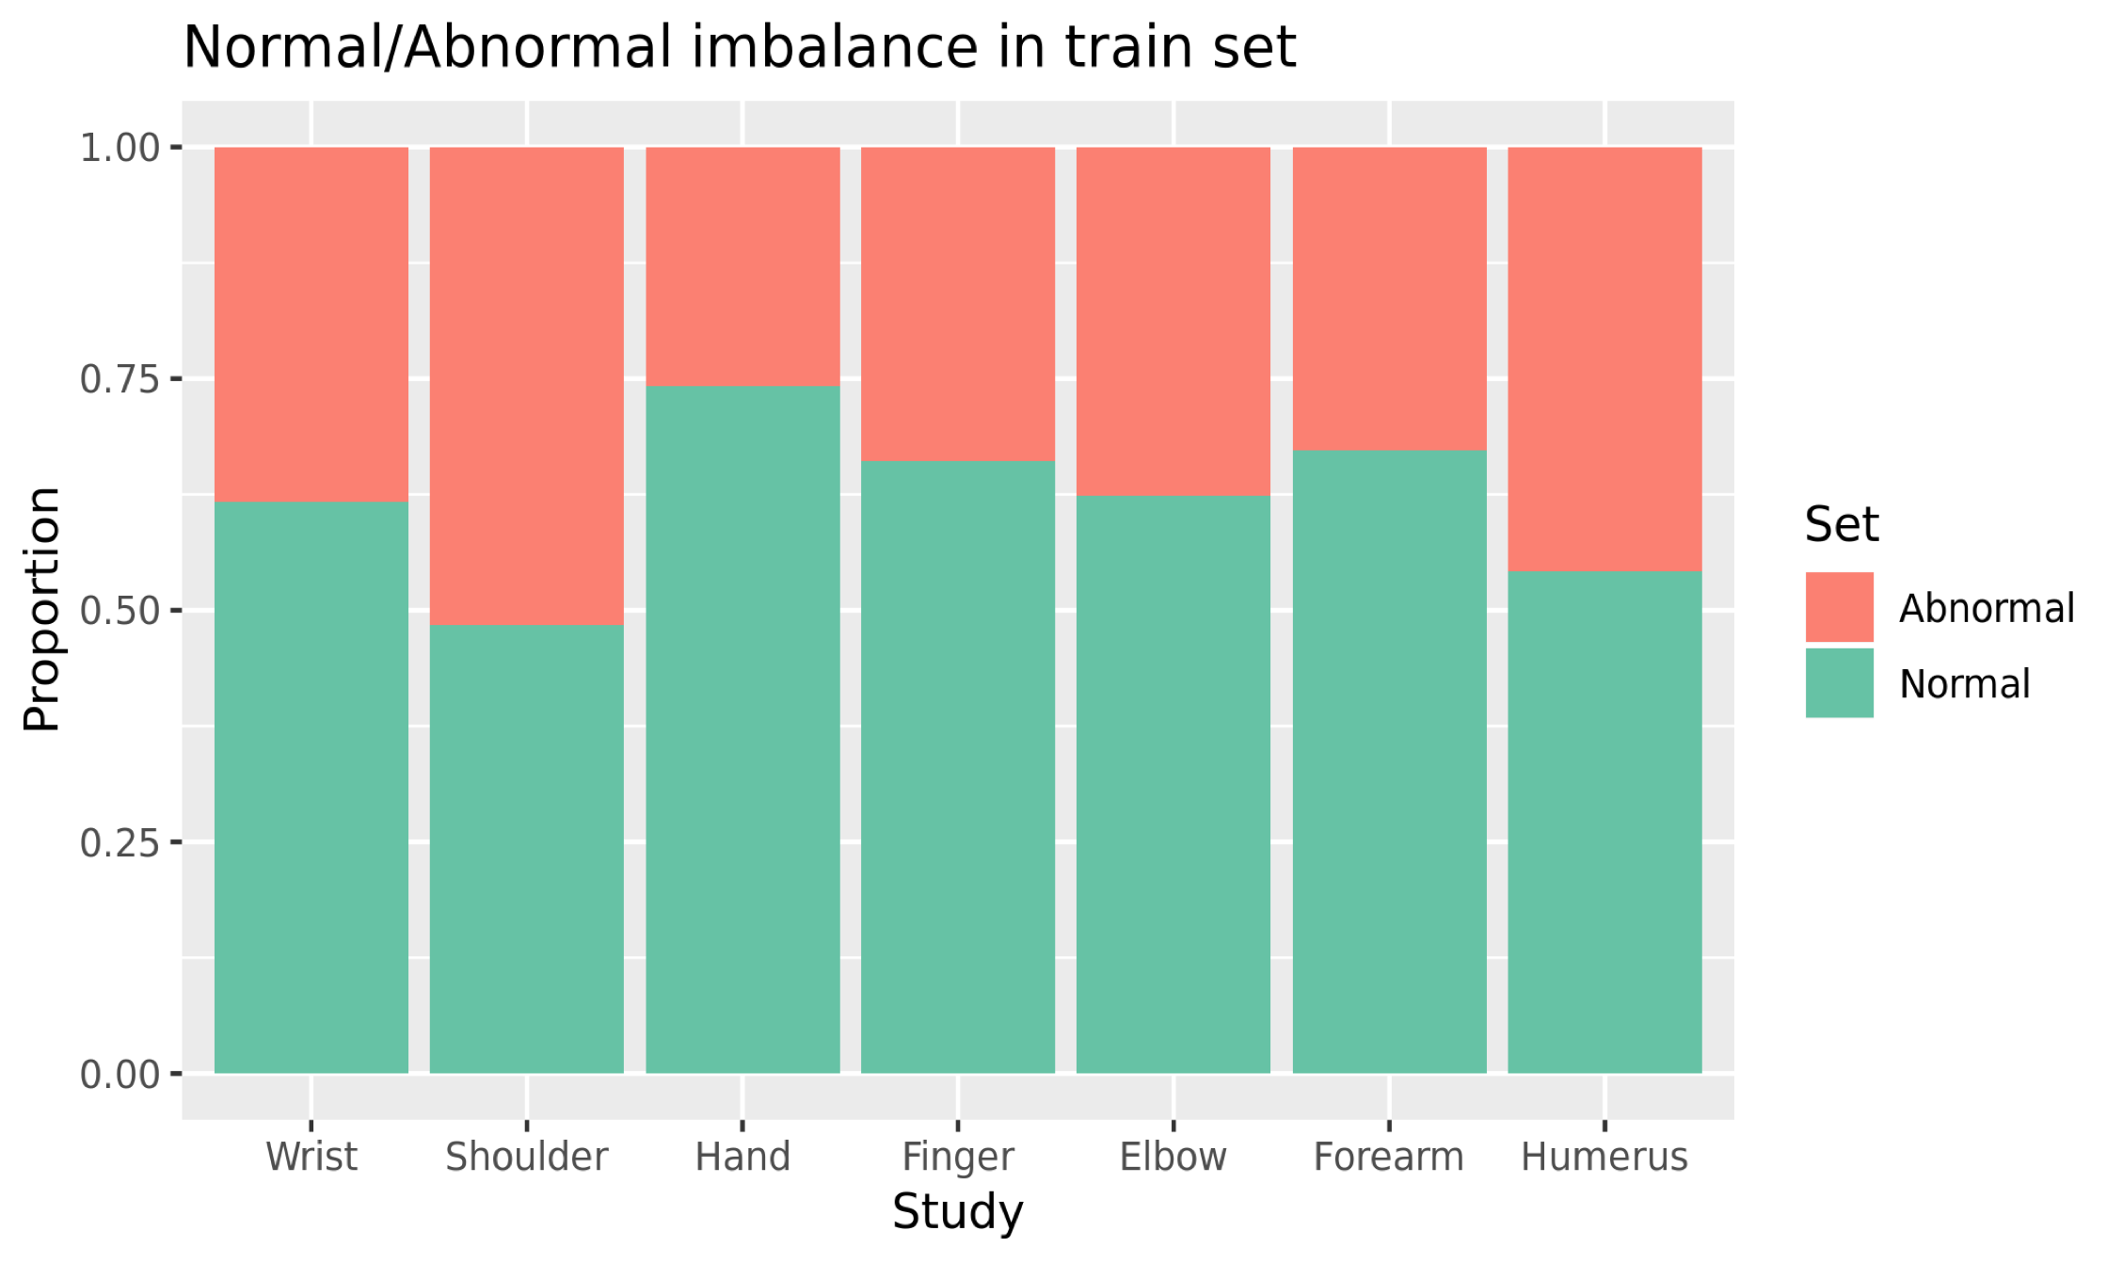
Class Imbalance

Slide 7
Pre-processing Images
Conversion of RGB images to grayscale as the inherent complexity of gray scale images is less than that of RGB images.
Resizing the images to 224 x 224 to enable the usage of pretrained weights for neural network
Normalization of images (scale : 0-1) to ensure each input parameter(i.e pixel) has a similar data distribution.

Slide 8
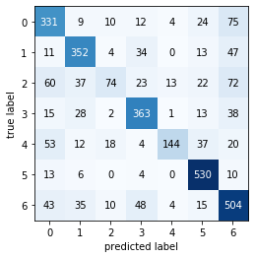
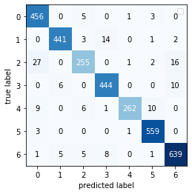
Models Considered for classification into study type
Random Forests
Neural Nets (ResNet)
Class #0 = ELBOW
Class #1 = FINGER
Class #2 = FOREARM
Class #3 = HAND
Class #4 = HUMERUS
Class #5 = SHOULDER
Class #6 = WRIST

Slide 9
Models Considered for classification into study type
Metrics for test set
Study type | Random Forest |  |  | Neural Nets(ResNet)
 | Accuracy | Precision | Recall | Accuracy | Precision | Recall
Hand | 0.93 | 0.74 | 0.79 | 0.98 | 0.95 | 0.96
Elbow | 0.89 | 0.63 | 0.71 | 0.98 | 0.92 | 0.98
Finger | 0.92 | 0.73 | 0.76 | 0.99 | 0.97 | 0.95
Forearm | 0.91 | 0.63 | 0.24 | 0.97 | 0.93 | 0.85
Humerus | 0.94 | 0.87 | 0.5 | 0.99 | 0.99 | 0.91
Shoulder | 0.95 | 0.81 | 0.94 | 0.99 | 0.97 | 0.99
Wrist | 0.86 | 0.66 | 0.76 | 0.98 | 0.96 | 0.97
Overall | 0.91 | 0.72 | 0.67 | 0.98 | 0.95 | 0.94

Slide 10
Neural Models for Abnormality Detection
Feed-Forward and simple Convolution neural network like VGG16 did not show significant results (accuracy <50%) even after a large number of epochs
Transfer learning using ResNet and DenseNet
Adam optimizer; SGD optimizer
Image augmentation

Slide 11
Data Processing for Transfer Learning
3 color channels to 1 gray channel (each pixel is 0 - 255)
Normalize (0 - 1)
Resize the images to 224x224 (ImageNet image size)
Normalize the images to have ImageNet mean and standard deviation
Mean of 0.456
Standard Deviation of 0.225

Slide 12
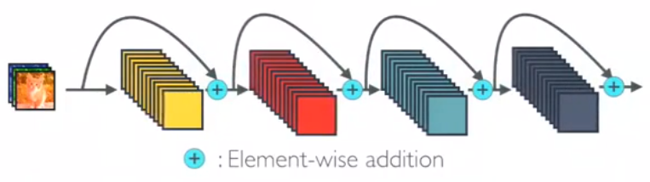
ResNet
Pictorial representation of ResNet
In ResNET identity mapping is proposed to promote the gradient propagation. Element-wise addition is used. It can be viewed as algorithms with a state passed from one ResNet module to another one.

Slide 13
ResNet
ResNet first introduced the concept of skip connection
Identity mapping is proposed to promote the gradient propagation
Mitigate the problem of vanishing gradient
Uses Batch Normalization at its core
Element-wise addition is used

Slide 14
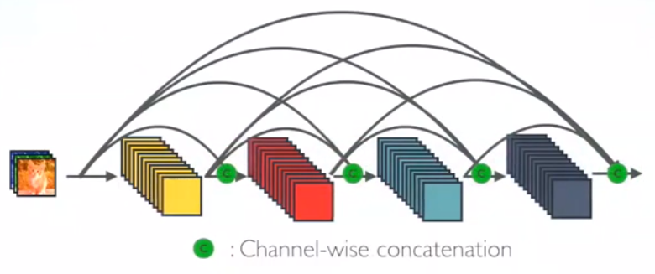
DenseNet
Pictorial representation of DenseNet
In DenseNet, each layer obtains additional inputs from all preceding layers and passes on its own feature-maps to all subsequent layers. Concatenation is used. Each layer is receiving a “collective knowledge” from all preceding layers.

Slide 15
DenseNet
Introduced in 2016 by Huang et. al
A type of residual net that emphasises on dense connection among layers
Composed of several “dense block” connected with single convolutional + pooling layer
Concatenation is used
Base paper uses the same architecture for their models

Slide 16
DenseNet
169 layers - block sizes (6, 12, 32, 32)
norm + conv + pool
2 * 6 (norm + conv + pool)
conv + pool
2 * 12 (norm + conv + pool)
norm + conv + pool
2 * 32 (norm + conv + pool)
norm + conv + pool
2 * 32 (norm + conv + pool)
linear (fully connected layer)

Slide 17
DenseNet
169 layers - block sizes (6, 12, 32, 32)
growth rate (k) = 32
change first and last layer
Change channel size from 3 to 1 for input layer
Change output size from 1000 to 1 for output layer
Relu activations
12.5M parameters (4.8k trainable)
No dropout
Sigmoid activation with BCE loss

Slide 18
DenseNet Vs ResNet (Metrics on Test set)
Study type | DenseNet169 |  |  | ResNet152
 | Accuracy | Precision | Recall | Accuracy | Precision | Recall
Elbow | 0.78 | 0.90 | 0.62 | 0.79 | 0.94 | 0.61
Wrist | 0.73 | 0.75 | 0.73 | 0.74 | 0.67 | 0.83
Shoulder | 0.68 | 0.66 | 0.69 | 0.67 | 0.62 | 0.85
Forearm | 0.75 | 0.78 | 0.69 | 0.68 | 0.65 | 0.77
Hand | 0.73 | 0.66 | 0.67 | 0.65 | 0.55 | 0.82
Finger | 0.68 | 0.67 | 0.83 | 0.66 | 0.64 | 0.83
Humerus | 0.75 | 0.69 | 0.87 | 0.78 | 0.73 | 0.89

Slide 19
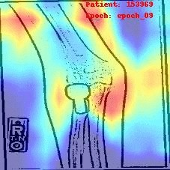
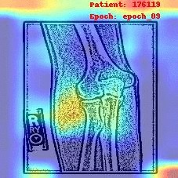
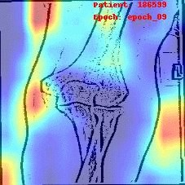
Activations(Future Scope)
Study type: elbow
Patient: 153969
Patient: 176119
Patient: 186599

Slide 20
DS 5220 Project Presentation

